Slide 2
CEO SHAVEZ
SECURING LIQUIDITY, ENSURING SUSTAINABILITY – WITH WE ARE ALL SATOSHI

Slide 3
WE ARE ALL SATOSHI PRODUCTS
Affiliate Program: Users can acquire COD20 Miners
and mine BITCOINCODE (BTCC) for “140 years”
GT-1X
GT-10X
GT-100X
50 SUSD
500 SUSD
5,000 SUSD

Slide 4
INTRODUCTION
A fascinating concept It combines the elements:
Arbitrage Trading
Artificial Intelligence
Zero Collateral Flash Loans

Slide 5
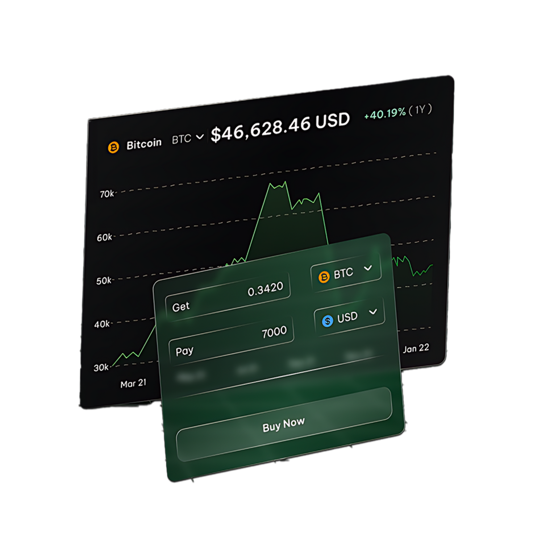
What is
ARBITRAGE?
Arbitrage involves exploiting price differences of the same asset in different markets or on different platforms.
For example, if an asset is priced lower on one exchange and higher on another, traders can buy the asset on the cheaper platform and sell it on the more expensive one, profiting from the price differential.
Arbitrage opportunities are often fleeting and require quick execution to capitalize on the price gaps.

Slide 6
What is
DEFI FLASH LOAN?
Flash loans are a relatively new form of uncollateralized loans They are available to traders on some decentralized finance protocols based blockchain networks(DeFi).
This type of loan allows traders to borrow unsecured loans from lenders without middleman.

Slide 7
What is
DEFI FLASH LOAN?
When a flash loan has been issued, the smart contract rules ensure that the borrower pays back the loan before the transaction ends. If this condition isn't met, the smart contract reverses the transaction and it's like the loan never happened in the first place.
This guarantees the safety of the funds in the reverse pool.

Slide 8
FLASH LOAN EXAMPLE
Flash Loan
10 ETH
Traded 10 ETH for Asset
DEX A
Asset is Undervalued
Traders use 10 ETH to buy an undervalued cryptocurrency on exchange A
Traded Asset A for 11 ETH
DEX B
Asset is Overvalued
Traders immediately sell the cryptocurrency on exchange B, where it is overvalued, for 11 ETH
Payback Flash Loan
10 ETH
1 ETH PROFIT

Slide 9
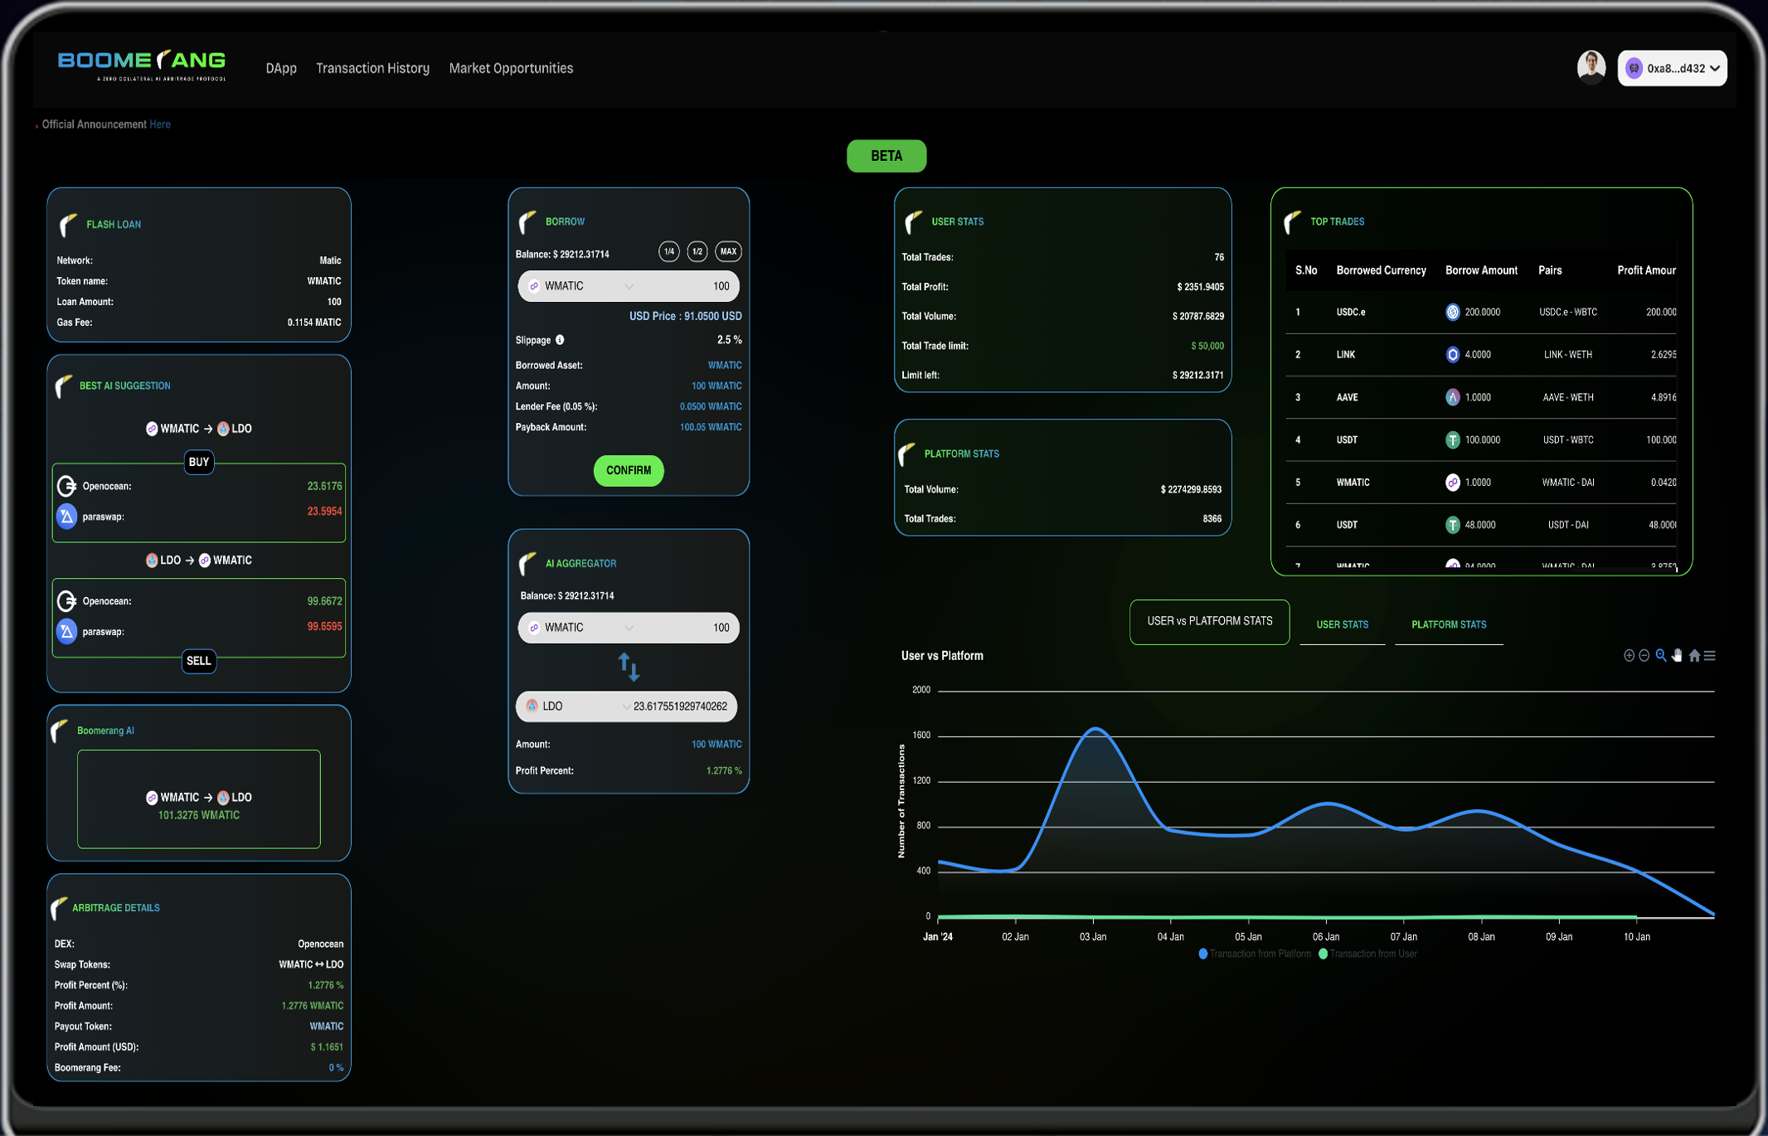
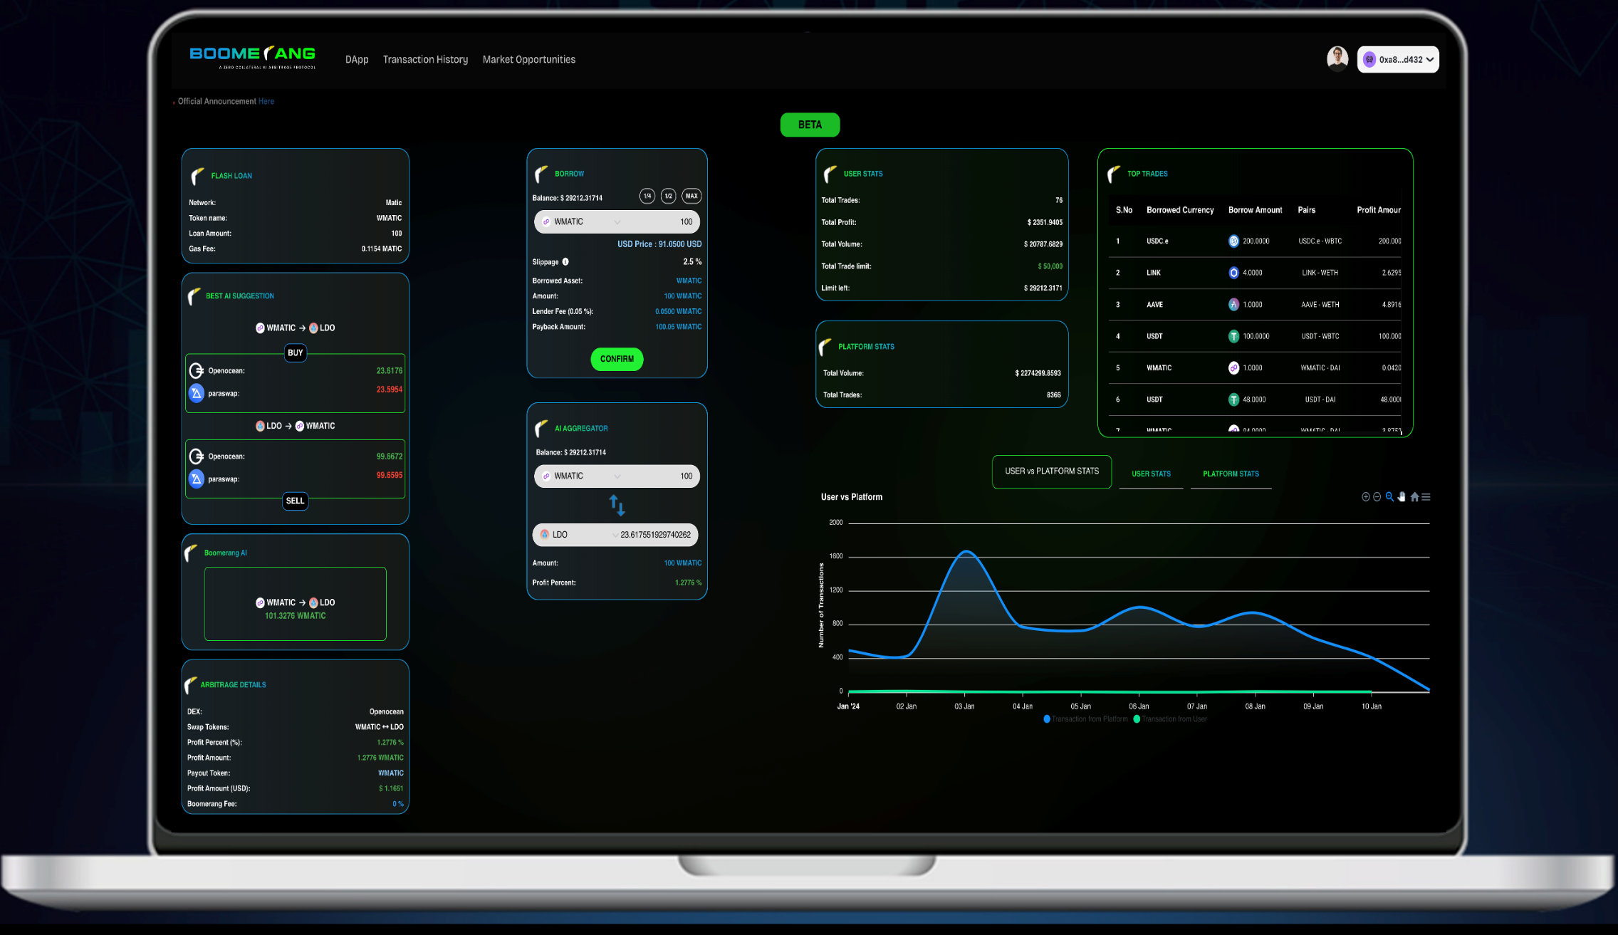
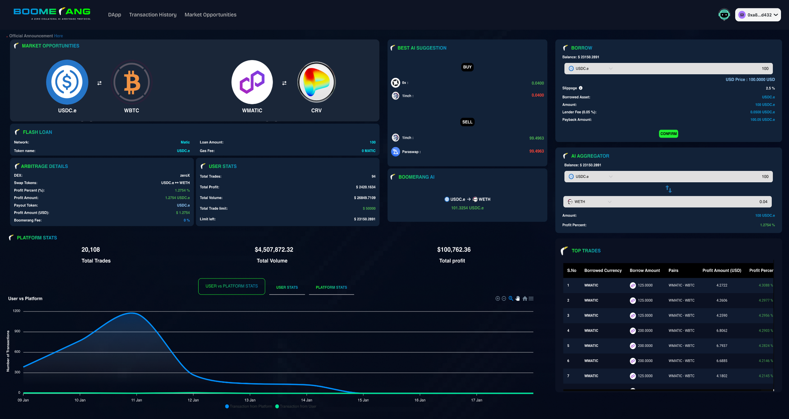
HIGHLIGHTING PROFITABLE ARBITRAGE POSSIBILITIES

Slide 10
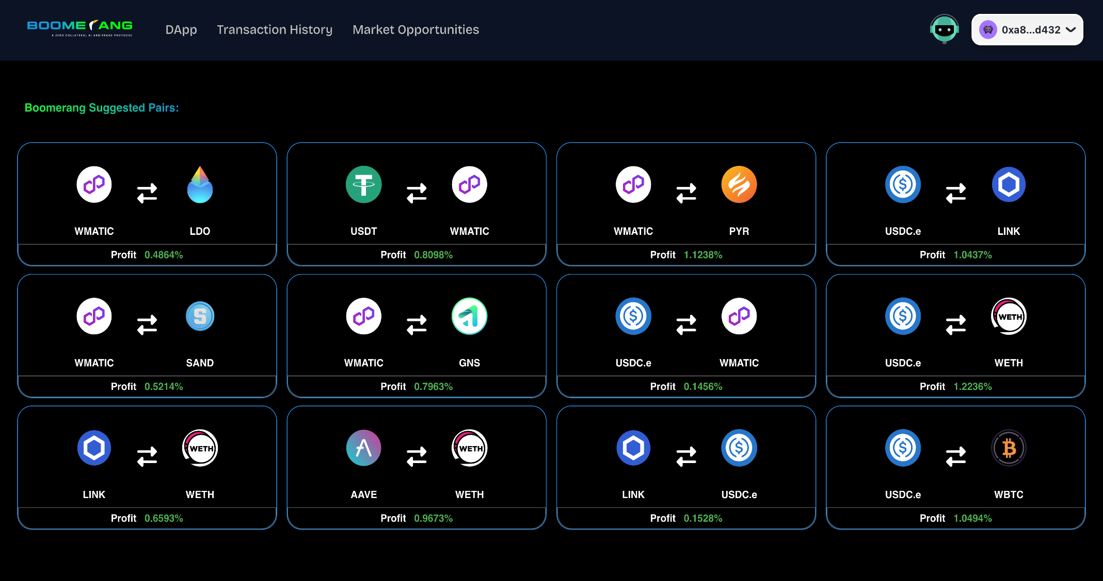
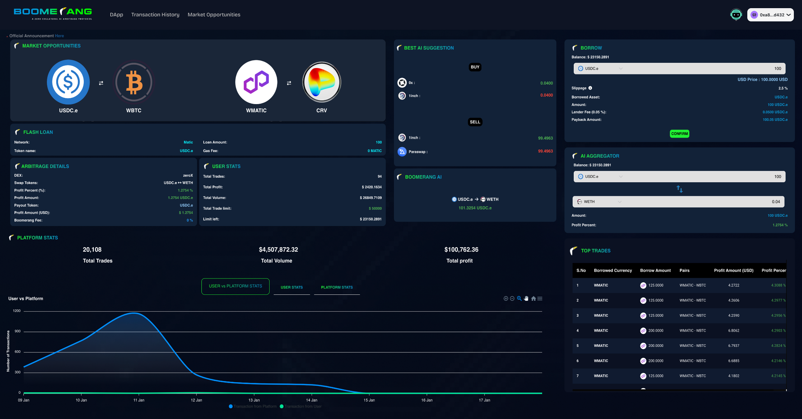
HIGHLIGHTING PROFITABLE ARBITRAGE POSSIBILITIES

Slide 11
HIGHLIGHTING PROFITABLE ARBITRAGE POSSIBILITIES

Slide 12
WE ARE ALL SATOSHI PRODUCTS
BOOMERANG
License 1
License 2
License 3
License 4
$500
$1,000
$3,000
$5,000
MVP
$100,000 FLASHLOAN
$200,000 FLASHLOAN
$600,000 FLASHLOAN
$1,000,000 FLASHLOAN
200X FLASH LOAN IS AVAILABLE ON MVP

Slide 13
WE ARE ALL SATOSHI PRODUCTS
$10,000
LICENCE 5
2 MILLION FLASH LOAN
MVP
200X FLASH LOAN IS AVAILABLE ON MVP

Slide 14
Affiliate
Marketing 2.0

Slide 15
AFFILIATE INCOME
WAAS compensation plan is a binary system
You
$
$
$
Become a Premium Subscriber
to open more opportunities to earn!
1 LEFT and 1 RIGHT and teach others to do the same!

Slide 16
AFFILIATE INCOME
INTRODUCER KICKBACKS
Subscribers can earn 5% rewards as Introducer Kickbacks for referring unlimited subscribers. This is from the 3rd paid subscription that you sponsor directly.
2) INTRODUCER KICKBACKS ON REPURCHASE
5% rewards are given when all personally introduced subscribers repurchase.
1 LEFT and 1 RIGHT and teach others to do the same!

Slide 17
AFFILIATE INCOME
$
CHECK MATCH BONUS
You
When you sponsor ONE subscriber on the LEFT and ONE subscriber on the RIGHT directly, you will qualify to receive Check Match Bonus of 10%
$
$
10%
NOTE: The Check Match Bonus is limited on a daily basis to $300, until you rank up. This capping for the Check Match Bonus increases as subscribers climb the ranks.
1 LEFT and 1 RIGHT and teach others to do the same!

Slide 18
PREMIUM BENEFITS
10% Matching Bonus
$500
$100
$500
$1000
$25
$25
$100
$125
5% Kickback Bonus
The Check Match Bonus is limited to a daily cap,
ranging from $300 TO $1500

Slide 19
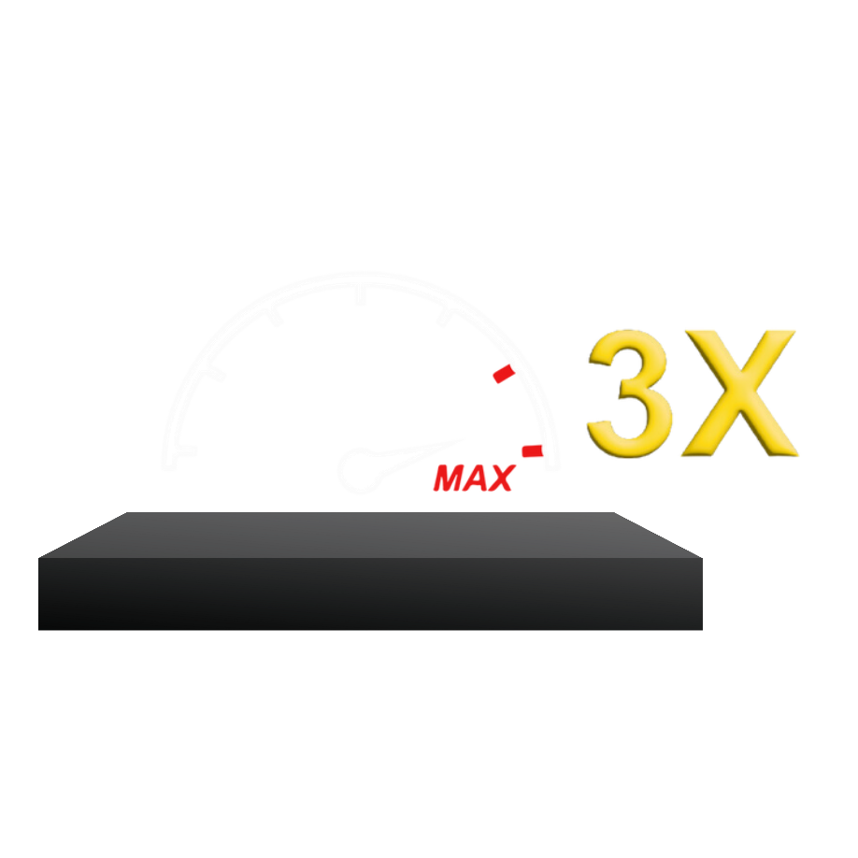
AFFILIATE POTENTIAL EARNINGS
Each time you subscribe to either a BTCC Miner or Boomerang license, this investment gets 3Xed. This is called Potential Earnings.
The potential earning amount for all income and bonuses is 3X your subscription amount.
Repurchases are available for all miners and Boomerang licenses!
Repurchases contribute to the total 3x potential income.

Slide 20
WE ARE ALL SATOSHI PRODUCTS
COD20 MINERS
50 1KW
500 10KW
5000 100KW
150 SUSD
1,500 SUSD
15,000 SUSD
Hash-ups contribute to the total 3x potential income.

Slide 21
WE ARE ALL SATOSHI PRODUCTS
BOOMERANG
500
$1,000
3,000
5,000
10,000
1,500 SUSD
3,000 SUSD
9,000 SUSD
15,000 SUSD
30,000 SUSD
Hash-ups contribute to the total 3x potential income.

Slide 22
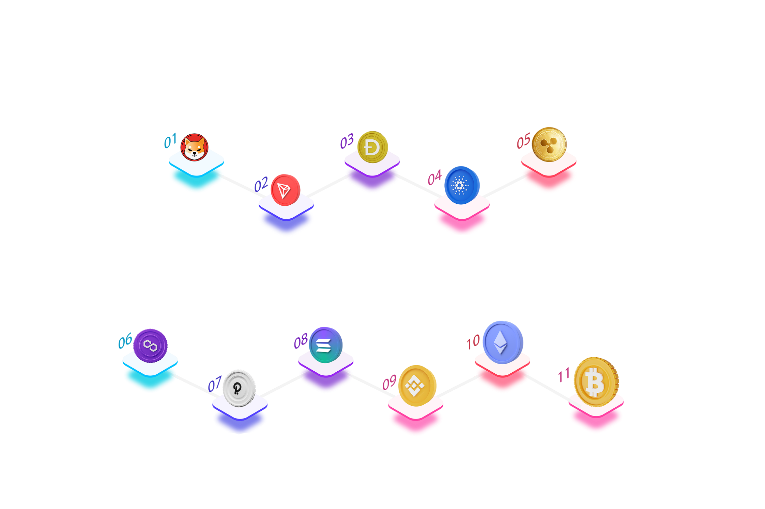
ASCENSION CLUB BONUS
ASCENSION CLUB BONUS
Ascension Club Bonus is rewarded to achievers who reach a certain rank
on the basis of fulfillment of Check Match Volume.
Ascension Club Bonus is rewarded to achievers who reach a certain rank on the basis of fulfillment of Check Match Volume.
RANK - TRON
RANK - CARDANO
CHECK MATCH VOLUME
CHECK MATCH VOLUME
250,000 ($420 cap)
750,000 ($540 cap)
ASCENSION CLUB REWARD - $2,000
ASCENSION CLUB REWARD - $4,000
RANK - SHIBA
RANK - DOGE
RANK - RIPPLE
CHECK MATCH VOLUME
CHECK MATCH VOLUME
CHECK MATCH VOLUME
100,000 ($360 cap)
500,000 ($480 cap)
1,000,000 ($600 cap)
ASCENSION CLUB REWARD - $1,000
ASCENSION CLUB REWARD - $3,000
ASCENSION CLUB REWARD - $5,000
RANK - BINANCE
RANK - BITCOIN
RANK - POLKADOT
CHECK MATCH VOLUME
CHECK MATCH VOLUME
CHECK MATCH VOLUME
5,000,000 ($1000 cap)
20,000,000 ($1500 cap)
3,000,000 ($800 cap)
ASCENSION CLUB REWARD - $1 MILLION
ASCENSION CLUB REWARD - $20,000
ASCENSION CLUB REWARD - $40,000
RANK - MATIC
RANK - SOLANA
RANK - ETHEREUM
CHECK MATCH VOLUME
CHECK MATCH VOLUME
CHECK MATCH VOLUME
2,000,000 ($700 cap)
4,000,000 ($900 cap)
10,000,000 ($1200 cap)
ASCENSION CLUB REWARD - $10,000
ASCENSION CLUB REWARD - $30,000
ASCENSION CLUB REWARD - $100,000

Slide 23
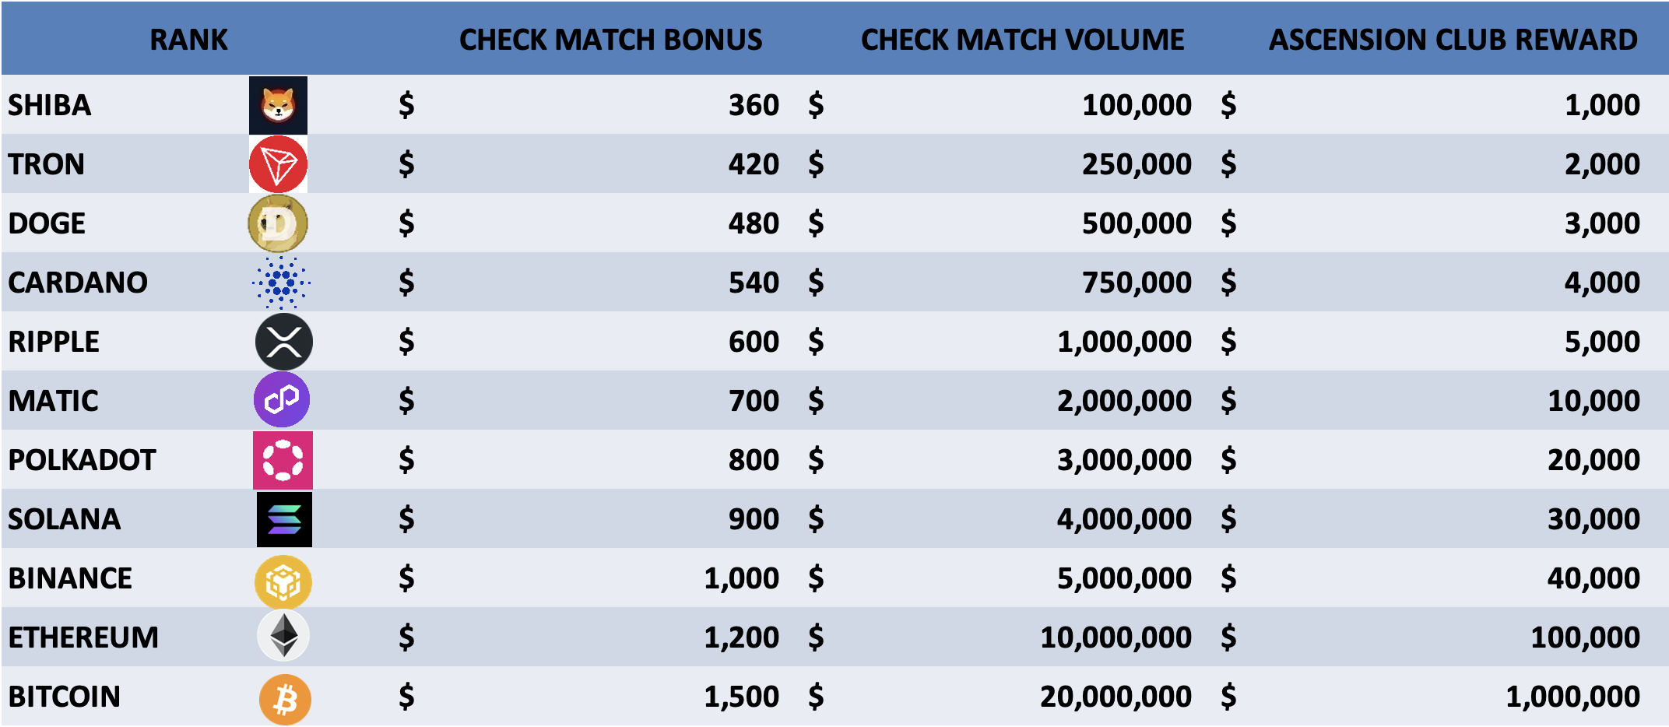
ASCENSION CLUB BONUS
ASCENSION CLUB BONUS
The Check Match Bonus is limited on a daily, ranking from $300 TO $1,500, depending on the RANK that has been attained. The capping for the Check Match Bonus increases as subscribers climb the ranks.
The daily capping on Check Match Bonus remains $300 until a certain rank is achieved.

Slide 24
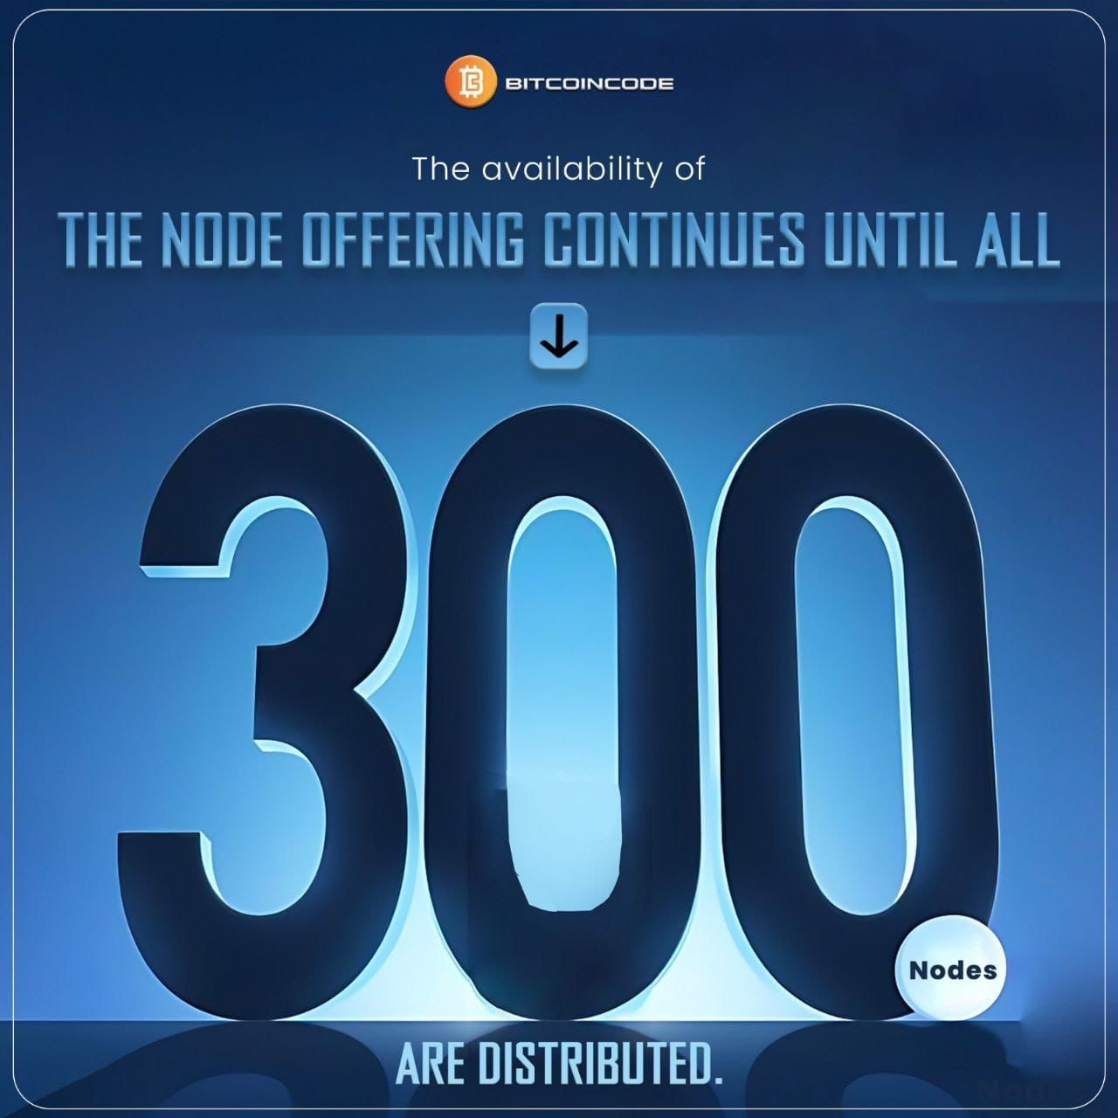
WE ARE ALL SATOSHI PRODUCTS
Affiliate Program: users can acquire NODE’S
LIMITED OFFER: 54,000 USD 182% APY

Slide 25
STRUCTURE POOL INCOME
And Monthly Rewards for Each Pool
MEGA POOL
GIGA POOL
Attain the Mega Pool by accomplishing a Business Volume of $1,000,000 of Boomerang licenses or by securing three Node subscriptions on both your Left and Right sides, and you'll be eligible to receive a monthly share of 4% of the total company revenue.
Attain the Giga Pool by accomplishing a Business Volume of $5,000,000 of Boomerang licenses or by having a minimum of 2 members who have achieved the Mega Node Pool Rank on both your Left and Right sides, and you'll be eligible to receive a monthly share of 7% of the total company revenue.
TERA POOL
Attain the Tera Pool by accomplishing a Business Volume of $10,000,000 of Boomerang licenses or by having at least 1 Giga member on both your Left and Right sides, and you'll be eligible to receive a monthly share of 10% of the total company revenue.
You will also be granted a FREE NODE subscription
MEGA POOL
GIGA POOL
$1,000,000
$1,000,000
$5,000,000
$5,000,000
TERA POOL
$10,000,000
$10,000,000

Slide 26
TERMS & CONDITIONS
A Flash Loan will be granted exclusively to whitelisted wallets and will have a free $50 GT-1X miner included.
On MVP, users who obtained a Boomerang License will be able to utilize their Flash Loan Limit.
All new purchased Boomerang Licenses will have a multiplier of 200X, the flash loan limits will be credited
on MVP.
Introducer Kickback and Check Match Bonuses are credited to the account on a daily basis.
Subscribers have the opportunity to receive Ascension Club Rewards from multiple clubs. (For Example: A subscriber has achieved Cardano rank in the club then they will receive Club Bonus from
Cardano, Doge, Tron & Shiba as well).
Ascension Club Rewards will be credited once a month.
All affiliate earnings are subject to a fixed 2% Admin fee, no withdrawal fees,
minimum deposit and withdrawal is 10 USDT.
Pool Income will be calculated based on the total company revenue for the period starting from the first day to the 30th day of each month.
The maximum earning amount for all income and bonuses is restricted (capped) to three times
(3x) the subscription amount. THE BITCOIN ASCENSION CLUB RANK HAS NO 3X CAPPING!

Slide 27
THANK YOU!
GRATITUDE FOR EXPLORING THE FUTURE OF TRADING WITH BOOMERANG.
EXCITING JOURNEYS AWAIT!

