Slide 1
BIGGEST MEME COIN LAUNCH
ON SOLANA BLOCKCHAIN
Powered by
RISK DISCLOSURE STATEMENT
SolHeist ecosystem consists of multiple meme coins that have no utility and are simply collectors item which inherently involve risks. These risks include potential loss of funds, volatility in asset prices, smart contract vulnerabilities, impermanent loss, market manipulation, regulatory uncertainty, and lack of insurance or recourse in case of adverse events. SolHeist is not responsible for any losses incurred. This information is provided for educational purposes only. Users are encouraged to conduct their own research and understand the risks before making any investment decisions.

Slide 2
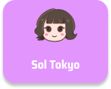
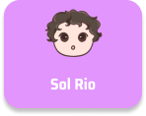
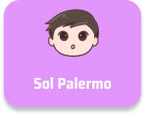
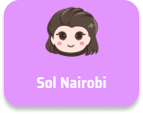
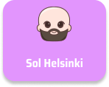
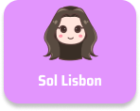
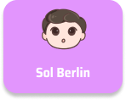
Introducing world’s first meme verse which includes Solhiest the main token and 10 Associated crew tokens.
Sol Heist

Slide 3
OPPORTUNITY
Meme coin market size
Solana market size
$50,482,978,870
$202,125,567,833
Market capitalisation
Market capitalisation
$12,728,775,824
$155,728,775,824
24h Trading volume
24h Trading volume
2.31 Billion daily swap trade volume
7.2 million daily swap trades
16 Million Monthly Active wallets
1.8 Million new monthly addresses

Slide 4
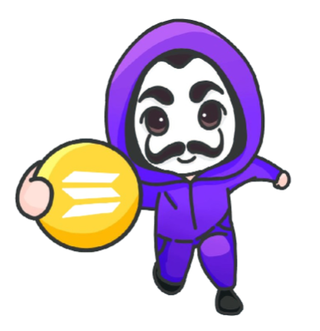
SOLHEIST TOKENOMICS
Liquidity
9 Billion
Market making
1 Billion
Max supply
14B
Pledge vesting
4 Billion
Raydium Swap Opening Liquidity :
9 Billion
Allocated for Pledge holders Vesting :
4 Billion
Market Makers & Exchange Listing :
1 Billion
Max supply:
14 Billion

Slide 5
CREW TOKENOMICS
Liquidity
90 Million
Market making
10 Million
Max supply
140M
Pledge vesting
40 Million
Raydium Swap Opening Liquidity :
90 Million
Allocated for Pledge holders Vesting :
40 Million
Market Makers & Exchange Listing :
10 Million
Max supply:
140 Million

Slide 6
MAKE A PLEDGE
What is a pledge?
SolHeist Pledge Benefits
Every pledge represents certain amount of solheist tokens. In case of Heist ecosystem a pledge means user pre buying tokens and holding them for a two year vesting period with gradual release.
Get SolHeist token
Get 25% crew tokens
Access to inner circle
SolHeist Pledge details
Crew Pledge details
1 Pledge = 1 Dollar
1 Crew Pledge = 1 Heist
1 Pledge = 40 SolHeist
1 Crew Pledge = 0.4 Crew token
Vesting period: 2yrs
Vesting period: 1yrs

Slide 7
PLEDGE DETAILS
Sale phases (Each phases is 15 days)
Phase 1 (+50%) - Buy 100 and get 50 pledges as bonus
Phase 2 (+40%) - Buy 100 and get 40 pledges as bonus
Phase 3 (+30%) - Buy 100 and get 30 pledges as bonus
Phase 4 (+20%) - Buy 100 and get 20 pledges as bonus
Crew Pledge Bonus drop details
Crew tokens bonuses will be directly sent to users wallet
Bonuses will be distributed whenever crew pledge sale goes live
Bonus drop date will be announced before going live
All crew pledges will have vesting period of one year
What is vesting?
Vesting in cryptocurrencies refers to the gradual or phased release of tokens or coins to stakeholders like employees, founders, investors, or community members.

Slide 8
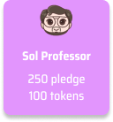
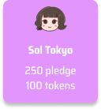
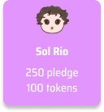
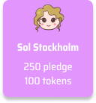
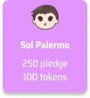
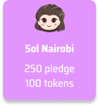
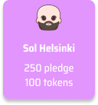
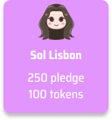
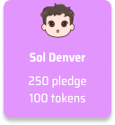
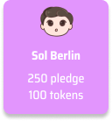
WHEN YOU INVEST $1,000, YOU GET
1,000 Pledges which is equal to 40,000 SolHeist
Plus bonus crew pledges
Solhiest pledges have a 2 year vesting period.
Crew pledges will have 1 year vesting period.
Tokens will be partially released daily until vesting period ends.

Slide 9
BECOME AN ADVOCATE
Help build SolHeist Community and earn 3 level of referrals
LEVEL 1: 20%
LEVEL 2: 10%
LEVEL 3: 5%
All referrals earning paid in two parts
50% Solana
50% Pledges
When you earn $100 in referral you get $50 worth of Solana and $50 worth of Pledges

Slide 10
SOL PROFESSOR'S ROADMAP
May 1
July
SOL Heist pledge campaign begins
SOL Professor pledge campaign commences.
July
Aug
SOL Heist launches on Solana DEXs & Top Tier 1 Exchanges.
SOL Professor Coin launches on all Solana DEXs & Top Tier 1 Exchanges.
Launching 10 unique characters
tied to the SOL Heist story, each with a total supply of only 140,000,000
Goal: become the largest MEME Coin by market cap!
You earn bonuses when pledges are made on all 10 coins!

Slide 11
SOL PROFESSOR'S ACTION PLAN
Push for Listing on tier 1 Exchanges
Start with 8 million in opening liquidity on solana Dex's
Canvas with Tier 1 Market makers to run Solheist market
Engage Top KOL's (Key opinion Leaders) via community
Engage top Influencers via community
Engage with best journalist's and crypto media houses to publish articles
Encourage community to run ads on Instagram, Facebook, Tiktok ads & reels
List on CMC, CG, Dextools, Dexscreener before launch
Run trader pre-registration campaigns on third party platforms

Slide 12
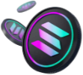
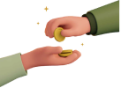
1
2
3
4
5
Download phantom wallet
Purchase
SOL
Grab your
invitation link
Make your pledge
Share your link and invite others to join the SOL community
LET'S MAKE HISTORY TOGETHER!

Slide 13
JOIN THE HEIST TODAY!
Powered by
RISK DISCLOSURE STATEMENT
SolHeist ecosystem consists of multiple meme coins that have no utility and are simply collectors item which inherently involve risks. These risks include potential loss of funds, volatility in asset prices, smart contract vulnerabilities, impermanent loss, market manipulation, regulatory uncertainty, and lack of insurance or recourse in case of adverse events. SolHeist is not responsible for any losses incurred. This information is provided for educational purposes only. Users are encouraged to conduct their own research and understand the risks before making any investment decisions.

